Slide 1
Brain tumor detection using multi-classification
Paper by:Pallavi Tiwari, Bhaskar Pant, Mahmoud M. Elarabawy, Mohammed Abd-Elnaby, Noor Mohd, 1 Gaurav Dhiman, 1 and Subhash Sharma.
Published 21 june 2020;

Slide 2
intro:
Brain tumors are the 10th leading reason for the death which is common among the adults and children.
For that we are going to discuss CNN model for classifying brain tumor using MRI pictures.
Our model classifies brain tumor into four classes: no tumor, glioma, meningioma, and pituitary tumor.

Slide 3
The data set we used in our model is Brain Tumor Classification (MRI) from the Kaggle licensed CCO: Public Domain.
It contains a total of 3264 MRIs.

Slide 4
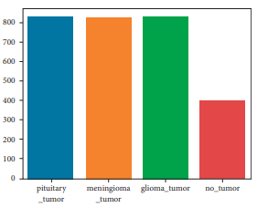
The dataset is categorized into two different parts training and testing dataset.
In the training dataset, the MRIs are distributed into four classes having 826, 822, 395, and 827 brain MRIs of glioma, meningioma, no tumor, and pituitary tumors, respectively.
Similarly, in the testing dataset, there are 100, 115, 105, and 74 brain MRIs of glioma, meningioma, no tumor, and pituitary tumor, respectively .

Slide 5
Why CNN?
Because CNN has shown to be the most successful DL technique for analyzing medical images.
It has a convolutional layer, activation layer, a batch normalization layer, a pooling layer, and a classification layer.
we will briefly talk about each of them:

Slide 6
A convolutional layer is responsible for recognizing features in pixels.
Batch Normalization Layer this layer’s primary function is to normalize the output of the layer previously. It may be utilized to prevent the problem of overfitting.
Activation Layer . one of the most essential parameters of the CNN model is the activation function. It defines which model information should be sent forward and which should not at the network’s end.

Slide 7
Pooling Layer: the work of this layer is to reduce the size of the feature map that means lowering the number of parameters and calculations needed to run the network.(the feature map is the output of the convolutional layer).
Classification Layer: the classification layer is the last layer in a CNN architecture. It is a fully connected feedforward network that’s frequently utilized as a classifier.

Slide 8
Our CNN model:
The CNN model compromises of 6 layers with weight, four convolution layers, 1 fully connected, and one output layer or classification layer. It also has six BN, activation (ReLU), three dropouts, one flatten, and one max-pooling layers in addition to these.

Slide 9
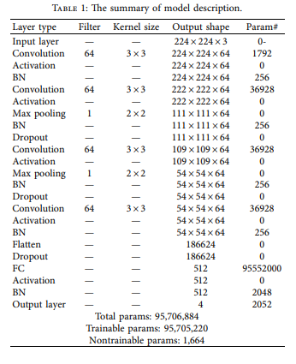

Slide 10
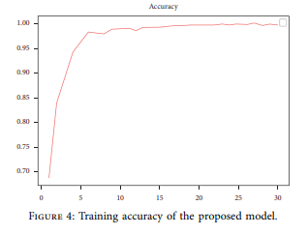
The model evaluation
The accuracy for our model is 99%

Slide 11
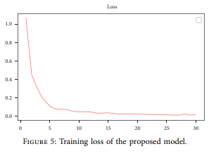
The loss

Slide 12
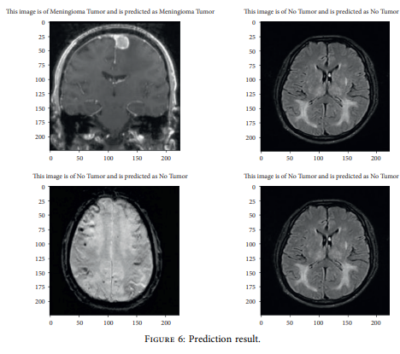
Prediction results:

Slide 13
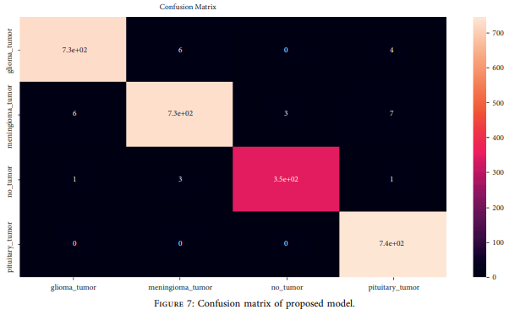
Our confusion matrix:

Slide 14
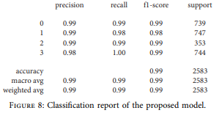
Our classification report:

Slide 15
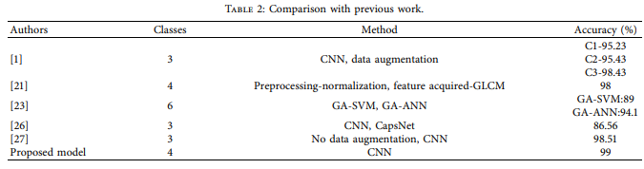
Comparison with previous work:

Slide 16
If you want to read more about our model follow the link of the paper below:
https://www.researchgate.net/publication/361460064_CNN_Based_Multiclass_Brain_Tumor_Detection_Using_Medical_Imaging

